Slide 1


Guided Meta-Policy Search
Russell Mendonca, Abhishek Gupta, Rosen Kralev, Pieter Abbeel, Sergey Levine, Chelsea Finn
From
EECS Department, UC Berkeley
Prensentation Prepared by
Isack T. Nicholaus
Computer Engineering, Dongseo University
ML/DL Research Lab
October, 2019

Slide 2
Contents
Introduction
Highlights
Motivations
Background
Proposed Method (Methodology)
Experiments & Results
Conclusion

Slide 3
Introduction
Meta-RL aims address the problem of requiring impractical numbers of sample for training by leveraging experience from previous learned tasks in order to more quickly solve new tasks.
However, in practice, these algorithms generally also require large amounts of on-policy experience during the meta-training process, making them impractical for use in many problems
1/17
Isack T. Nicholaus– Computer Engineering, Dongseo University, Busan, South Korea – 2019
Notes:
-
The training of procedure for is to maximize the probability of D making a mistake. This framework corresponds to a minimax two-player game.
In the space of arbitrary functions G and D, a unique solution exists, with G recovering the training data distribution and D equal to ½ everywhere.
3

Slide 4

Highlights
Learn a reinforcement learning procedure through imitation of expert policies that solve previously-seen tasks.
Nested optimization, with RL in the inner loop and supervised imitation learning in the outer loop.
Any benefit? Yes,
Significant gains in meta-learning sample efficiency because Imitation learning can be done with off-policy data.
General idea in this paper can be use for both meta-learning and for learning fast RL procedures from multi-task demonstration data.
2/17
Isack T. Nicholaus– Computer Engineering, Dongseo University, Busan, South Korea – 2019
Notes:
-
The training of procedure for is to maximize the probability of D making a mistake. This framework corresponds to a minimax two-player game.
In the space of arbitrary functions G and D, a unique solution exists, with G recovering the training data distribution and D equal to ½ everywhere.
4

Slide 5
Motivations
Current meta-RL methods are generally limited to much simpler domains, such as relatively low-dimensional continuous control tasks and navigation with discrete action commands.
Optimization stability and sample complexity are major challenges for the meta-training phase.
Recent techniques requiring 250 million transitions for meta-learning in tabular MDPs, which typically require a fraction of a second to solve in isolation.
3/17
Isack T. Nicholaus– Computer Engineering, Dongseo University, Busan, South Korea – 2019
Notes:
-
The training of procedure for is to maximize the probability of D making a mistake. This framework corresponds to a minimax two-player game.
In the space of arbitrary functions G and D, a unique solution exists, with G recovering the training data distribution and D equal to ½ everywhere.
5

Slide 6
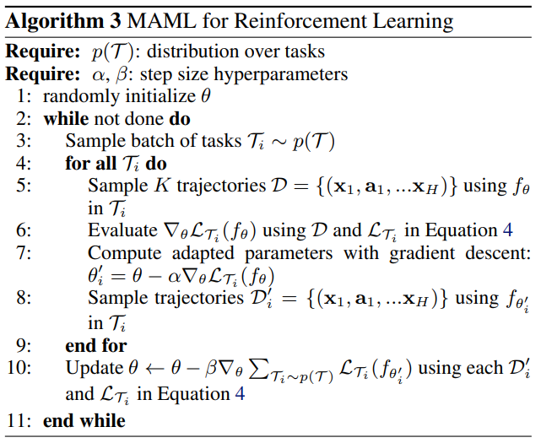

Preliminaries
6
4/17
Isack T. Nicholaus– Computer Engineering, Dongseo University, Busan, South Korea – 2019

Slide 7
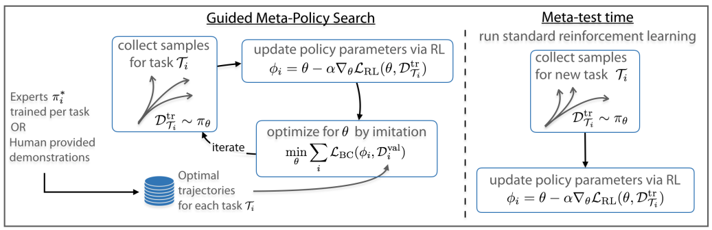
Figure 1. Overview of the guided meta-policy search algorithm: We learn a policy π_{θ} which is capable of fast adaptation to new tasks via reinforcement learning, by using reinforcement learning in the inner loop of optimization and supervised learning in the meta-optimization. This algorithm either trains per-task experts π∗_{i} or assumes that they are provided by human demonstrations, and then uses this for meta-optimization. Importantly, when faced with a new task we can simply perform standard reinforcement learning via policy gradient, and the policy will quickly adapt to new tasks because of the meta-training.
Guided Meta-Policy Search Algorithm
5/17
Isack T. Nicholaus– Computer Engineering, Dongseo University, Busan, South Korea – 2019
Notes:
-
The training of procedure for is to maximize the probability of D making a mistake. This framework corresponds to a minimax two-player game.
In the space of arbitrary functions G and D, a unique solution exists, with G recovering the training data distribution and D equal to ½ everywhere.
7

Slide 8
Guided Meta-Policy Search Algorithm
First phase: task learning, agents learn policies for each of the meta-learning tasks.
Instead of learning policies explicitly through reinforcement learning, we can also obtain expert demonstrations from a human demonstrator.
In the second phase, meta-learning, we will learn to reinforcement learn using these policies as supervision at the meta-level.
In particular, we train for a set of initial parameters θ such that only one or a few steps of gradient descent produces a policy that matches the policies learned in the first phase.
8
6/17
Isack T. Nicholaus– Computer Engineering, Dongseo University, Busan, South Korea – 2019

Slide 9
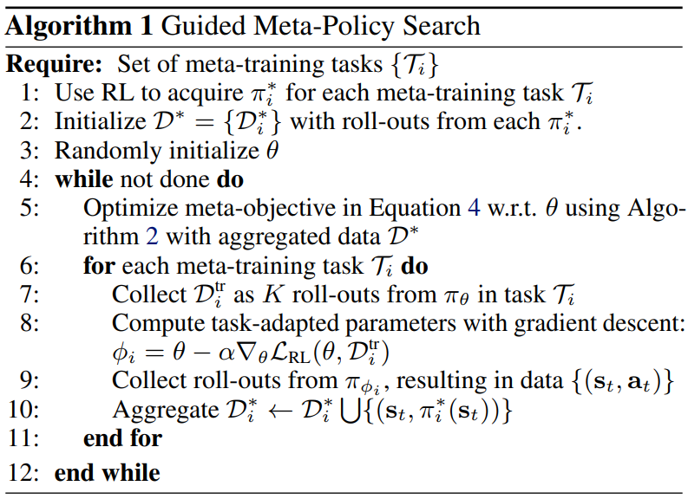

Guided Meta-Policy Search Algorithm
7/17
Isack T. Nicholaus– Computer Engineering, Dongseo University, Busan, South Korea – 2019
Notes:
-
The training of procedure for is to maximize the probability of D making a mistake. This framework corresponds to a minimax two-player game.
In the space of arbitrary functions G and D, a unique solution exists, with G recovering the training data distribution and D equal to ½ everywhere.
9

Slide 10


Guided Meta-Policy Search Algorithm
The goal of the algorithm in meta-learning phase is to optimize the same meta-objective as the MAML algorithm,
Where denotes the parameters of the policy adapted to task T_{i} via gradient descent.
The inner policy optimization will remain the same as the policy-gradient MAML algorithm; however, we will optimize this meta-objective by leveraging the policies learned in the first phase (task learning phase).
8/17
Isack T. Nicholaus– Computer Engineering, Dongseo University, Busan, South Korea – 2019
Notes:
-
The training of procedure for is to maximize the probability of D making a mistake. This framework corresponds to a minimax two-player game.
In the space of arbitrary functions G and D, a unique solution exists, with G recovering the training data distribution and D equal to ½ everywhere.
10

Slide 11
Guided Meta-Policy Search Algorithm
Implementation of the Second phase: First roll out each of the policies ( ) to collect a dataset trajectories D∗_{i} for each of the meta-training tasks T_{i.}
Using initial dataset, we update our policy according to the following meta-objective:
The result of this optimization is a set of initial policy parameters θ that can adapt to a variety of tasks, to produce , in a way that comes close to the expert policy’s actions.
Supervised learning provides stable, low-variance gradients, behavior cloning objectives are known to be prone to compounding errors.
9/17
Isack T. Nicholaus– Computer Engineering, Dongseo University, Busan, South Korea – 2019
Notes:
11

Slide 12
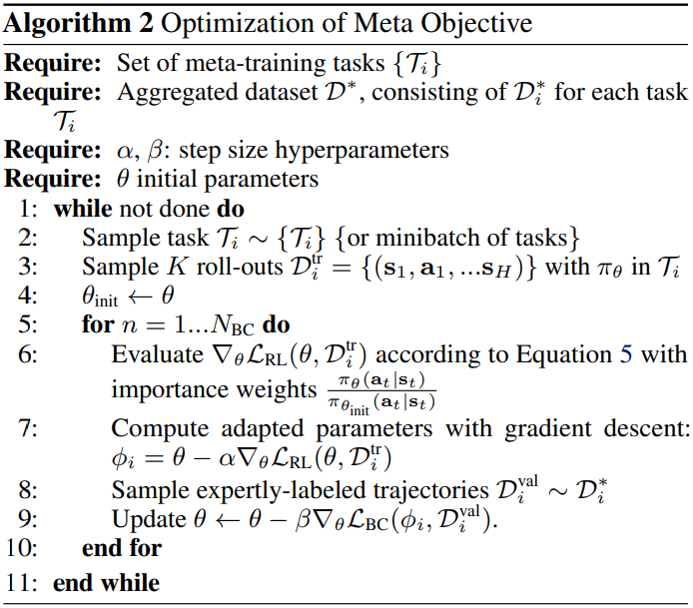

Optimization Algorithm
10/17
Isack T. Nicholaus– Computer Engineering, Dongseo University, Busan, South Korea – 2019
Notes:
12

Slide 13
Expert Policy Optimization
The first phase of our algorithm entails learning policies for each of the meta-training tasks.
We can employ efficient off-policy reinforcement learning algorithms that are faster and current improve the efficiency of this approach by employing a contextual policy to represent the experts, which simultaneously uses data from all of the tasks.
Crucially, the context only needs to be known during meta-training.
In the experiment we employ contextual and soft-actor critic (SAC)
11/17
Isack T. Nicholaus– Computer Engineering, Dongseo University, Busan, South Korea – 2019
Notes:
-
The training of procedure for is to maximize the probability of D making a mistake. This framework corresponds to a minimax two-player game.
In the space of arbitrary functions G and D, a unique solution exists, with G recovering the training data distribution and D equal to ½ everywhere.
13

Slide 14
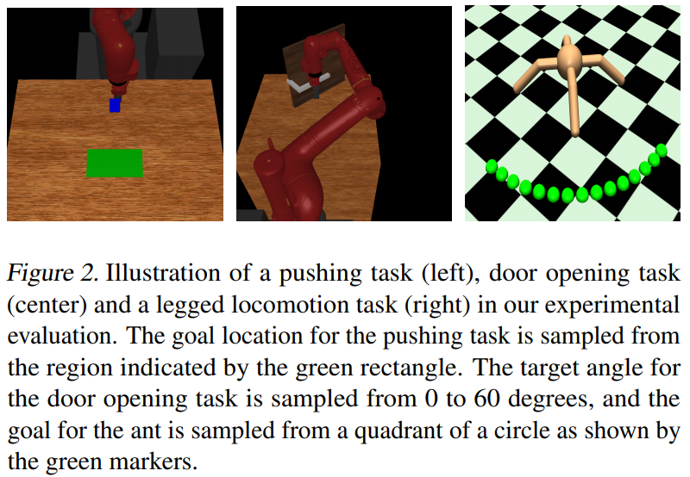
Experiments (1/5)
12/17
Isack T. Nicholaus– Computer Engineering, Dongseo University, Busan, South Korea – 2019
Notes:
-
The training of procedure for is to maximize the probability of D making a mistake. This framework corresponds to a minimax two-player game.
In the space of arbitrary functions G and D, a unique solution exists, with G recovering the training data distribution and D equal to ½ everywhere.
14

Slide 15
Experiments (2/5)
Sawyer Manipulation Tasks
Pushing, full state: The tasks involve pushing a block with a fixed initial position to a target location sampled from a 20 cm × 10 cm region.
Pushing, vision: Same as above, except the policy receives an RGB image instead of the block position.
Door opening: The task distribution involves opening a door to a target angle sampled uniformly from 0 to 60 degrees. The target angle is not present in the observations, and must be implicitly inferred through trial-and-error.
13/17
Isack T. Nicholaus– Computer Engineering, Dongseo University, Busan, South Korea – 2019
Notes:
-
The training of procedure for is to maximize the probability of D making a mistake. This framework corresponds to a minimax two-player game.
In the space of arbitrary functions G and D, a unique solution exists, with G recovering the training data distribution and D equal to ½ everywhere.
15

Slide 16
Experiments (3/5)
Quadrupedal Legged Locomotion
The task distribution comprises goal positions sampled uniformly from the edge of a circle with radius 2 m, between 0 and 90 degrees.
We have a dense-reward version vision of the environment to evaluate GMPS as a meta-RL algorithm, and a sparse-reward version where we evaluate GMPS with demonstrations.
14/17
Isack T. Nicholaus– Computer Engineering, Dongseo University, Busan, South Korea – 2019
Notes:
-
The training of procedure for is to maximize the probability of D making a mistake. This framework corresponds to a minimax two-player game.
In the space of arbitrary functions G and D, a unique solution exists, with G recovering the training data distribution and D equal to ½ everywhere.
16

Slide 17
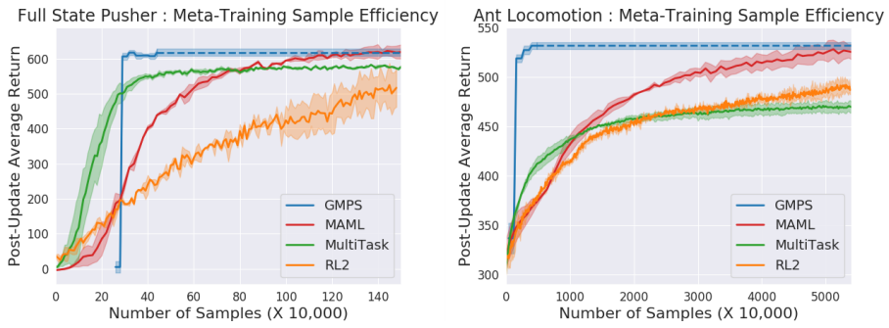
Experiments Results (4/5)
Figure 3. Meta-training sample efficiency comparison on full state pushing (left) and dense reward ant locomotion (right). All methods reach approximately the same asymptotic performance, but GMPS is able to achieve the performance with significant gains in sample efficiency
15/17
Isack T. Nicholaus– Computer Engineering, Dongseo University, Busan, South Korea – 2019
Notes:
-
The training of procedure for is to maximize the probability of D making a mistake. This framework corresponds to a minimax two-player game.
In the space of arbitrary functions G and D, a unique solution exists, with G recovering the training data distribution and D equal to ½ everywhere.
17

Slide 18
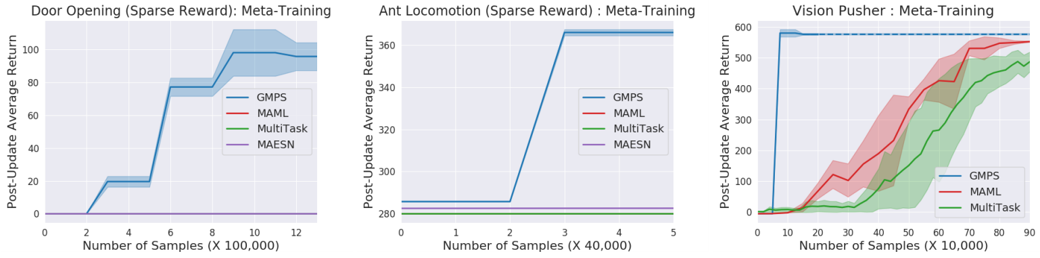
Experiments Results (5/5)
Figure 4. Meta-training comparisons for sparse reward door opening (left), sparse reward ant locomotion (middle) and vision pusher (right). Our method is able to learn when only sparse rewards are available for adaptation, whereas prior methods struggle. For vision-based tasks, we find that GMPS is able to effectively leverage the demonstrations to quickly and stably learn to adapt.
16/17
Isack T. Nicholaus– Computer Engineering, Dongseo University, Busan, South Korea – 2019
Notes:
-
The training of procedure for is to maximize the probability of D making a mistake. This framework corresponds to a minimax two-player game.
In the space of arbitrary functions G and D, a unique solution exists, with G recovering the training data distribution and D equal to ½ everywhere.
18

Slide 19
Conclusion
In this work, we presented a meta-reinforcement learning algorithm that learns efficient reinforcement learning procedures via supervised imitation.
This enables a substantially more efficient meta-training phase that incorporates expert-provided demonstrations to drastically accelerate the acquisition of reinforcement learning procedures and priors.
17/17
Isack T. Nicholaus– Computer Engineering, Dongseo University, Busan, South Korea – 2019
Notes:
-
The training of procedure for is to maximize the probability of D making a mistake. This framework corresponds to a minimax two-player game.
In the space of arbitrary functions G and D, a unique solution exists, with G recovering the training data distribution and D equal to ½ everywhere.
19

Slide 20
Reference
Guided Meta-Policy Search Algorithm: https://arxiv.org/pdf/1904.00956.pdf
Model-Agnostic Meta-Learning for Fast Adaptation of Deep Networks: https://arxiv.org/pdf/1703.03400.pdf
Isack T. Nicholaus – Computer Engineering, Dongseo University, Busan, South Korea – 2019
Notes:
-
The training of procedure for is to maximize the probability of D making a mistake. This framework corresponds to a minimax two-player game.
In the space of arbitrary functions G and D, a unique solution exists, with G recovering the training data distribution and D equal to ½ everywhere.
20

Slide 21
Thank You
Notes:
-
The training of procedure for is to maximize the probability of D making a mistake. This framework corresponds to a minimax two-player game.
In the space of arbitrary functions G and D, a unique solution exists, with G recovering the training data distribution and D equal to ½ everywhere.
21

